Slide 1
Meat–Seafood–dessert sale!
Stock your freezer…Support our building fund!

Slide 2
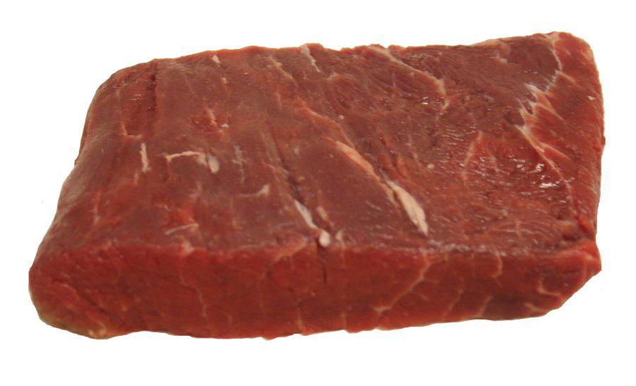
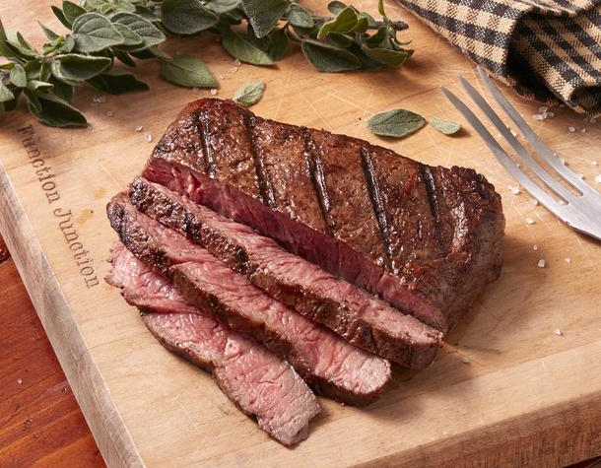
6 oz. Flat Iron Steaks
Individually wrapped

Slide 3
5 oz. Bacon Wrapped Pork Filets
Individually
Wrapped
deliciousness

Slide 4
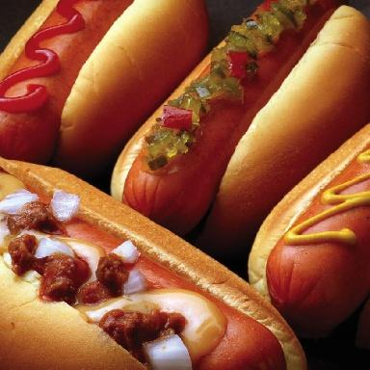
5 lb. Berks 7” Pretzel Dogs All Beef Hotdogs (All Beef - Nathans)

Slide 5
3 lb. bag Chicken Breast (16 – 4 oz.)

Slide 6
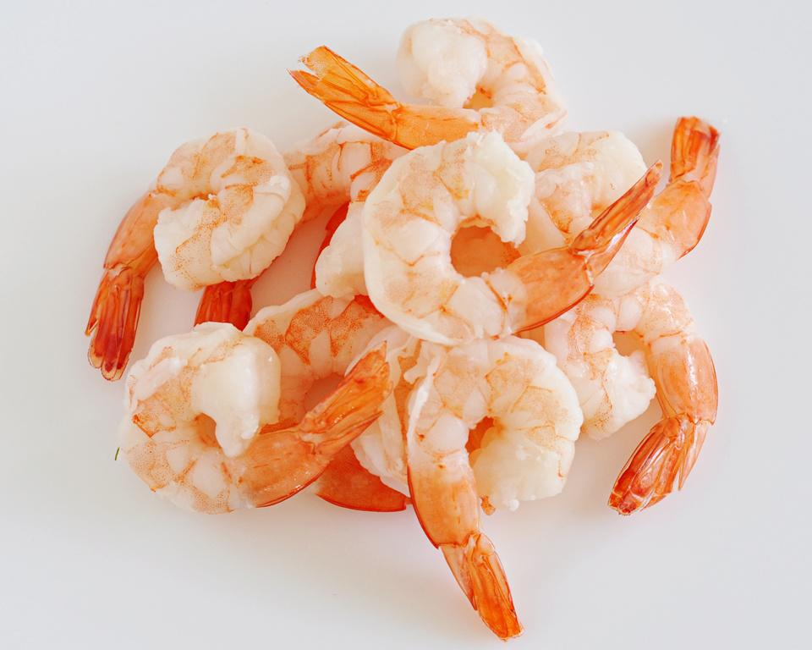
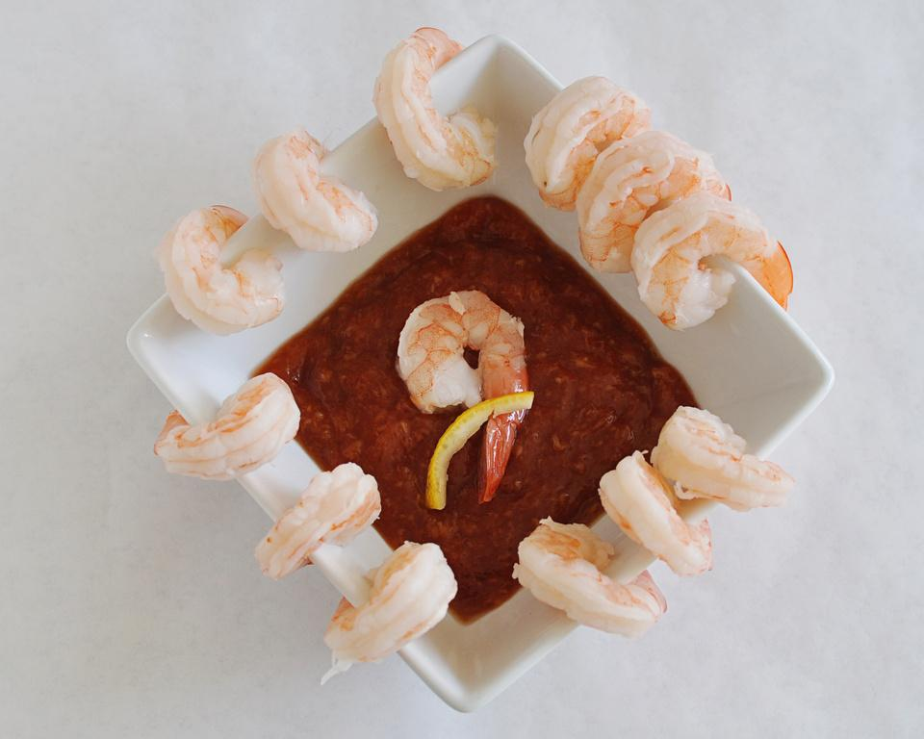
2.5 lb. bag Peeled + Deveined Shrimp

Slide 7
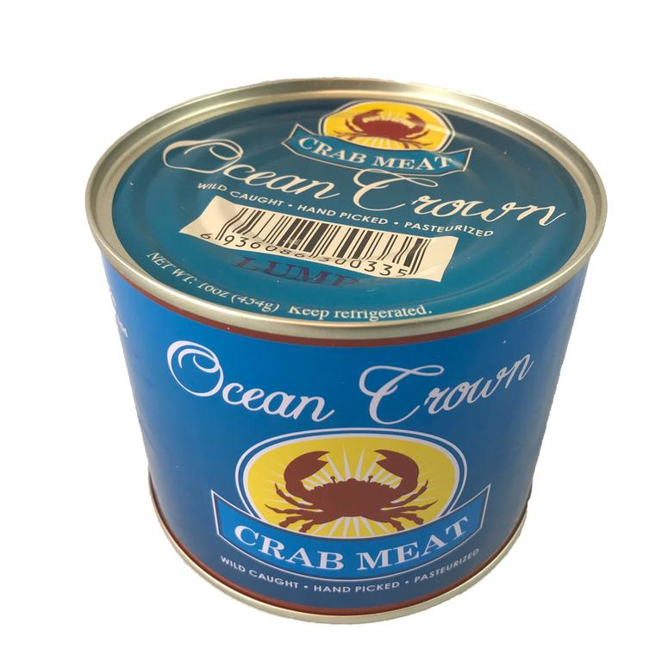
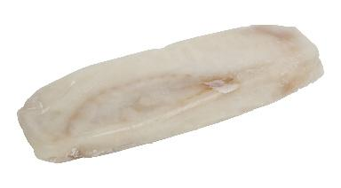
1 lb. can Lump 5 lb. box Cello Crab Meat Haddock Filets

Slide 8
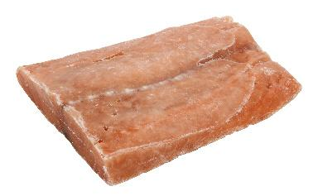
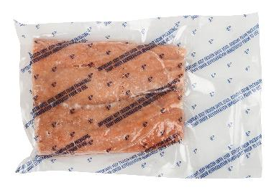
4 oz. Salmon Filets

Slide 9
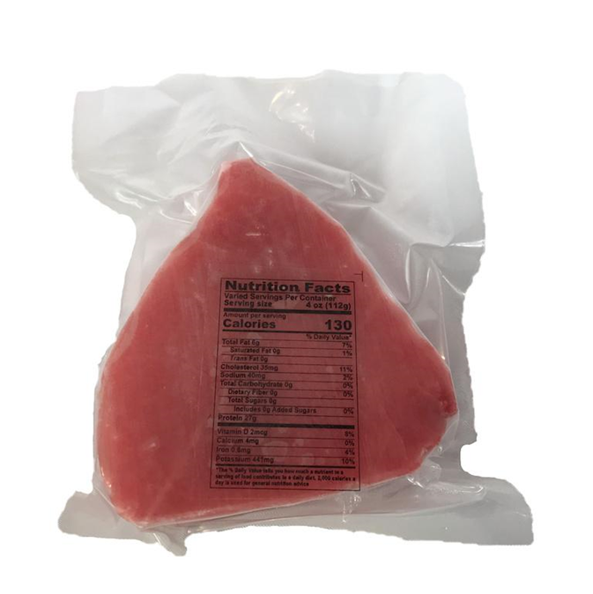
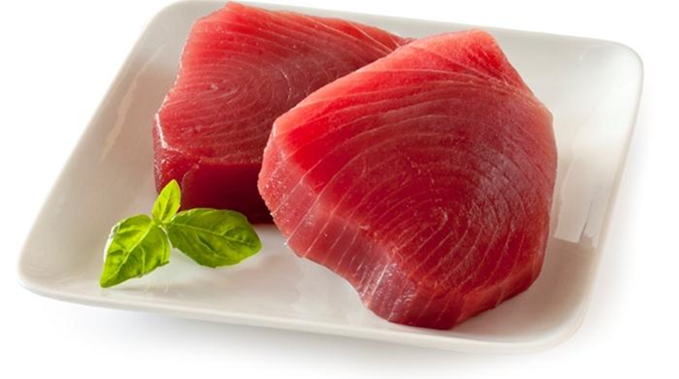
6 oz. Yellow Fin Tuna Steaks

Slide 10
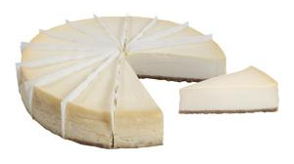
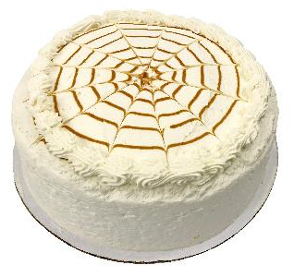
Cheesecake Pumpkin Spice Cake
Great for parties…just unthaw!

Slide 11
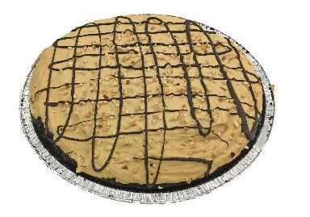
Peanut Butter triple chocolate Pie cake

Slide 12
*Take forms to your work… *share them with your family… *buy some and give as presents… *prepare in case your husband isn’t the greatest shot…
What does this mean for me??

Slide 13
This helps you get some easy, delicious, healthy meals all while helping st. peter’s building fund grow so that we can better serve our community.
Pick up some order forms and hand them out to everyone you know!

Slide 14
Orders due by Sept. 25th
Delivery October 2nd from 5-8pm

Slide 15
Check out the products in the foyer
You can buy them today!

